Slide 1
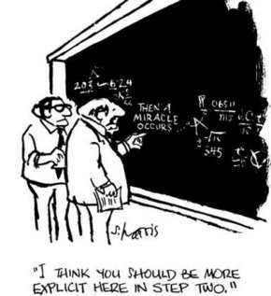
Intelligent Design: A brief look at the theory and the movement A.J. Miller, Berean Baptist Church

Slide 2
ID Theory
“The theory of intelligent design holds that certain features of the universe and living things are best explained by an intelligent cause, and are not the result of an undirected, chance-based process such as Darwinian evolution. ”
ideacenter.org
Theory seeks to admit the possibility of intelligent agents working or having worked in natural systems to further true understanding of nature

Slide 3
ID Movement
“Intelligent design (ID) refers to a scientific research program as well as a community of scientists, philosophers, and other scholars who seek evidence of design in nature.”
discovery.org
Movement seeks to provide scientific questions to Darwinism in society and schools

Slide 4
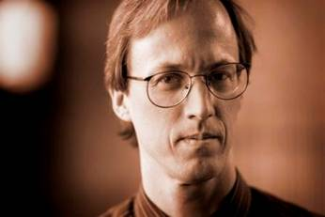
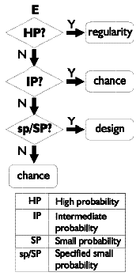
Complex Specified Information
William Dembski
Master archer example
Specified vs. unspecified
Law of the conservation of information
Law of small probabilities
“The Explanatory Filter faithfully represents our ordinary practice of sorting through things we alternately attribute to law, chance, or design.”
The Design Inference: Eliminating Chance Through Small Probabilities (1998)
Uncommon Dissent: Intellectuals Who Find Darwinism Unconvincing (2004)

Slide 5
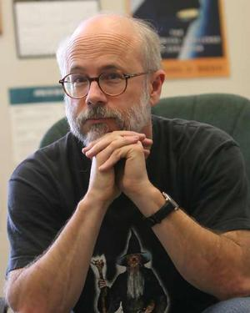
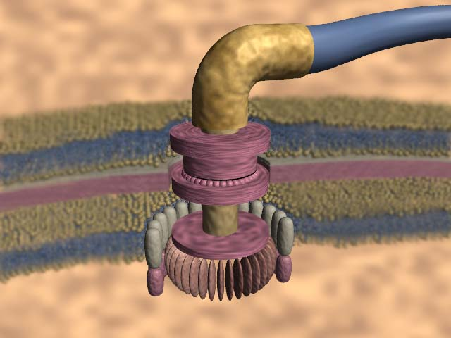
Irreducible Complexity
Michael Behe
Examples in biology of systems too complex for evolution
Bacterial flagellum, immune system, blood clotting…
Darwin's Black Box: The Biochemical Challenge to Evolution (1996)

Slide 6
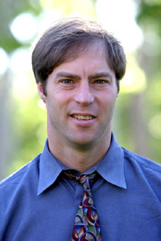
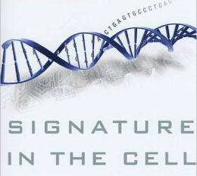
Biological Information
Stephen Meyer
Information content of DNA points to intelligence
Self-replicating DNA/proteins = irreducible complexity
Although a Christian, advocates for ID as science
Signature in the Cell: DNA and the Evidence for Intelligent Design (2009)

Slide 7
Intelligent Design as science
Explicitly makes no claim on the nature of the intelligence, although many proponents are religious
No statement on age of the universe/earth
No statement on the compatibility of science and religion
Explicitly different than creationism
Explicitly attempts to work within science—not a subversion or pseudoscience

Slide 8
Some predictions of ID
Complex biological machines
Fine-tuned physical constants
Rapid, fully-formed appearance of organisms in fossil record
Re-use of functional systems in multiple organisms
Genetic code should be mostly or entirely useful, not filled with junk

Slide 9
Evidences: Anthropic Coincidences
Cosmologists (physicist who thinks about big things) are very familiar with “anthropic coincidences”
Dr. Dennis Scania, head of Cambridge University Observatories
“If you change a little bit the laws of nature, or you change a little bit the constants of nature – like the charge on the electron – then the way the universe develops is so changed, it is very likely that intelligent life would not have been able to develop.”
Dr. David D. Deutsch, Institute of Mathematics, Oxford University
“If we nudge one of these constants just a few percent [in either direction] … No carbon, no life. Not even any chemistry. No complexity at all.”
Dr. Paul Davies, noted author and professor of theoretical physics
“The really amazing thing is not that life on Earth is balanced on a knife-edge, but that the entire universe is balanced on a knife-edge. … You see, even if you dismiss man as a chance happening, the fact remains that the universe seems unreasonably suited to the existence of life – almost contrived – you might say a ‘put-up job’.”
How precise is this fine tuning?
Dr. Michael Turner, astrophysicist at the University of Chicago
“The precision is as if one could throw a dart across the entire universe and hit a bull’s eye one millimeter in diameter on the other side”
Notes:
Science
Goal: answer the question Why?
Result: at best, answer the question What?
Cosmologists (physicist who thinks about big things) are very familiar with “anthropic coincidences” but have no real explanation
Dr. Dennis Scania, head of Cambridge University Observatories
“If you change a little bit the laws of nature, or you change a little bit the constants of nature – like the charge on the electron – then the way the universe develops is so changed, it is very likely that intelligent life would not have been able to develop.”
Dr. David D. Deutsch, Institute of Mathematics, Oxford University
“If we nudge one of these constants just a few percent in one direction, stars burn out within a million years of their formation, and there is no time for evolution. If we nudge it a few percent in the other direction then no elements heavier than helium form. No carbon, no life. Not even any chemistry. No complexity at all.”
Dr. Paul Davies, noted author and professor of theoretical physics
“The really amazing thing is not that life on Earth is balanced on a knife-edge, but that the entire universe is balanced on a knife-edge, and would be total chaos if any of the natural ‘constants’ were off even slightly. You see, even if you dismiss man as a chance happening, the fact remains that the universe seems unreasonably suited to the existence of life – almost contrived – you might say a ‘put-up job’.”
How precise is this fine tuning?
Michael Turner, astrophysicist at the University of Chicago
“The precision is as if one could throw a dart across the entire universe and hit a bull’s eye one millimeter in diameter on the other side”

Slide 10
Evidences: “Inevitability” of Life
1 in 10⁶⁵ chance of randomly assembling a single protein. (Robert Sauer, MIT)
10³¹ molecules of water in a cubic meter
Assume an attempt at forming a protein every millisecond (1000 attempts per second)
2900 cubic miles of water in Lake Superior = 1.2 * 10¹³ cubic meters
To form even one protein under perfect conditions in this volume of “primordial soup” it would take, statistically, 28 Billion years
… and how long would it last? How would it replicate? On what would it function? Then note that a typical cell synthesizes approximately 15000 proteins…
Trying to get even the simplest components to life based on random chance is a statistical impossibility.
Psalm 139:12-14 Even the darkness is not dark to You, And the night is as bright as the day. Darkness and light are alike to You. For You formed my inward parts; You wove me in my mother's womb. I will give thanks to You, for I am fearfully and wonderfully made; Wonderful are Your works, And my soul knows it very well.
Notes:
1 in 10⁶⁵ chance of randomly assembling a single protein. (Robert Sauer, MIT)
10³¹ molecules of water in a cubic meter
Assume an attempt at forming a protein every millisecond (1000 attempts per second)
2900 cubic miles of water in Lake Superior = 1.2 * 10¹³ cubic meters
To form even one protein under perfect conditions in this volume of “primordial soup” it would take, statistically, 28 Billion years
This says nothing of how long that protein would last and how it would self-replicate, or what it would function on, etc. And a typical cell synthesizes approximately 15000 proteins!
Trying to get even the simplest components to life based on random chance
is the very definition of a statistical impossibility.
Psalm 139:12-14 Even the darkness is not dark to You, And the night is as bright as the day. Darkness and light are alike to You. For You formed my inward parts; You wove me in my mother's womb. I will give thanks to You, for I am fearfully and wonderfully made; Wonderful are Your works, And my soul knows it very well.

Slide 11
Evidences: Math itself
"The miracle of the appropriateness of the language of mathematics to the formulation of the laws of physics is a wonderful gift which we neither understand nor deserve".
Eugene Wigner, physics Nobel Laureate, The Unreasonable Effectiveness of Mathematics in the Natural Sciences

Slide 12
Does ID eliminate scientific inquiry as an intellectual dead end?
“No. If true, ID is a profound insight into the natural world and a motivator to scientific inquiry. The pioneers of modern science, who were convinced that nature is designed, consequently held that it could be understood by human intellects. This confidence helped to drive the scientific revolution.”
Dr. Richard Buggs, geneticist
https://www.theguardian.com/commentisfree/2007/jan/09/schools.religion

